Slide 1
FUNDAMENTALS OF ACCOUNTING FOR NON-ACCOUNTANTS

Slide 2
Accounting Concepts and Principles

Slide 3
Generally Accepted Accounting Principles (GAAP)
“Rules, procedures, practice and standards followed in the preparation and presentation of financial statement.”
A common set of accounting principles, standards and procedures that companies use to compile their financial statements.
A combination of authoritative standards (set by policy boards) and simply the commonly accepted ways of recording and reporting accounting information.
Were developed on the basis of experience, reason, custom, usage and practical necessity.

Slide 4
GAAP includes principles on:
Recognition – what items should be recognized in the financial statements (for example as assets, liabilities, revenues, and expenses)
Measurement – what amounts should be reported for each of the elements included in the financial statements.
Presentation – what line items, subtotals and totals should be displayed in the financial statements and how might items be aggregated within the financial statements.
Disclosure – what specific information is most important to the users of the financial statements. Disclosures both supplement and explain amounts in the statements.

Slide 5
UNDERLYING ASSUMPTIONS
Accounting principles serve as bases in preparing, presenting and interpreting financial statements. They provide a foundation to prevent misunderstanding between and among the preparers and users.
The Conceptual Framework of Accounting mentions the underlying assumption of going concern.
Going Concern Assumption
Also known as continuing concern concept or continuity assumption, means that a business entity will continue to operate indefinitely, or at least for another twelve months.
Is the reason assets are generally presented in the balance sheet at cost rather that at fair market value. Long-term assets are included in the books until they are fully utilized and retired.

Slide 6
IMPLICIT ACCOUNTING ASSUMPTIONS
A. Accounting Entity Concept
Recognizes a specific business enterprise as one accounting entity, separate and distinct from the owners, managers, and employees of that business.
A company has its own identity set apart from its owners or anyone else.
Personal transactions of the owners, managers, and employees must not be mixed with transactions of the company.
B. Time Period (Periodicity)
Also known as periodicity assumption, means that the indefinite life of an enterprise is subdivided into time periods (accounting periods) which are usually of equal length for the purpose of preparing financial reports on financial position, performance and cash flows.

Slide 7
An accounting period is usually a 12-month period – either calendar or fiscal
Calendar year – a 12-month period ending December 31
Fiscal year – a 12-month period ending in any day throughout the year, for example April 1 to March 31 of the following year.
Interim period is any period which is less than 12 months and reports (monthly or quarterly) which covers such period is called interim reports/statements.

Slide 8
ACCRUAL BASIS OF ACCOUNTING
“revenue or income is recognized when earned regardless of when received and expenses are recognized when incurred regardless of when paid.”

Slide 9
Financial Statements
Formal reports prepared by accountants
Statements that show the organization’s financial results, financial condition, and cash flows.
The end product of the financial accounting process.

Slide 10
The components of a complete set of financial statements
Statement of Financial Position (Balance Sheet)
Statement of Financial Operations (Income Statement)
Statement of Comprehensive Income
Statement of Cash Flows
Statement of Changes in Equity
Notes to Financial Statements (comprising of significant accounting policies and other explanatory notes)

Slide 11
The elements of the financial statements
Assets – are resources controlled by the entity as a result of past events and from which future economic benefits are expected to flow to the entity.
Liabilities – are defined as present obligations of the entity arising from past events.
Equity – is defined as the residual interest in the assets of the entity after deducting all its liabilities.
Income - refers to the increases in economic benefits during the accounting period in the form of inflows or enhancements of assets or decreases of liabilities that result in increases in equity.
Expenses – refers to the decreases in economic benefits during the accounting period in the form of outflows.

Slide 12
CHART OF ACCOUNTS
A chart of accounts (COA) is an index of all the financial accounts in the general ledger of a company. In short, it is an organizational tool that provides a digestible breakdown of all the financial transactions that a company conducted during a specific accounting period, broken down into subcategories.

Slide 13
Chart of Accounts Examples:

Slide 15
Book of Accounts
Book of Accounts is a book where you record all the financial transactions of the business. Entries in the books of accounts are required to be supported with documents such as official receipts, sales invoices, vouchers and other related supporting documents evidencing the business transactions occur.

Slide 16
WHAT ARE THE KINDS OF BOOKS OF ACCOUNTS?
Regardless of the method you will choose, the books of accounts are composed of General Journal and the General Ledger.
1. General Journal
This is called the book of original entry because this is the first book where the business transaction are recorded. Journalizing is the process of recording in the journal.
2. General Ledger
This is called the book of final entry. In this book, you can see the ending balance of each account you record in General Journal and Special Journals. Posting is the process of recording in the general ledger.

Slide 17
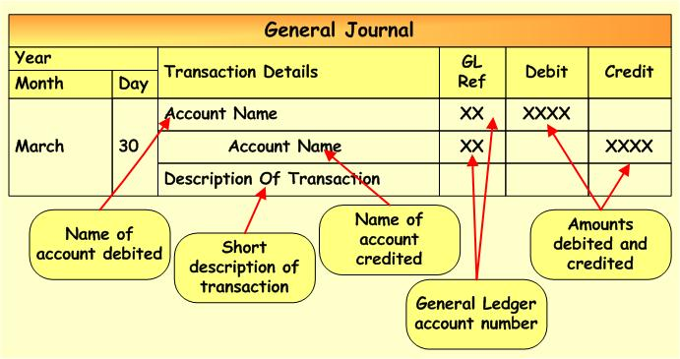

Slide 18
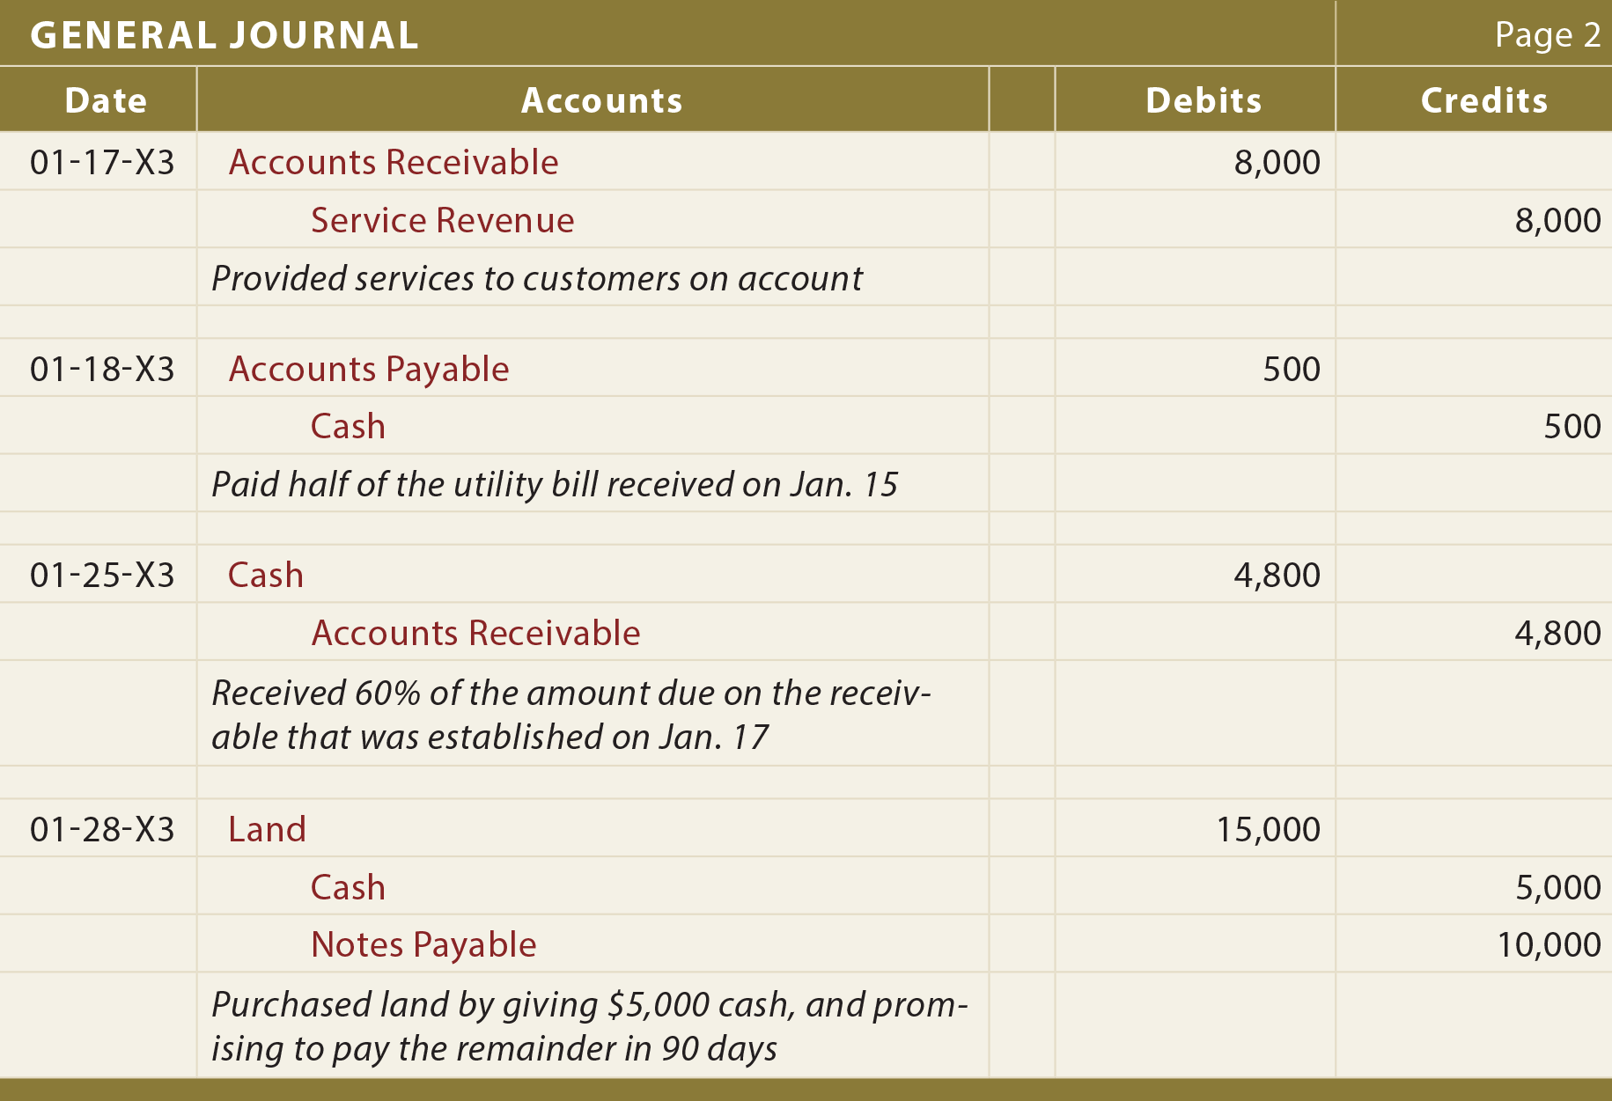

Slide 19
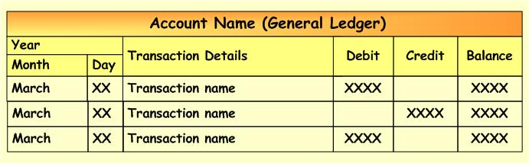

Slide 20
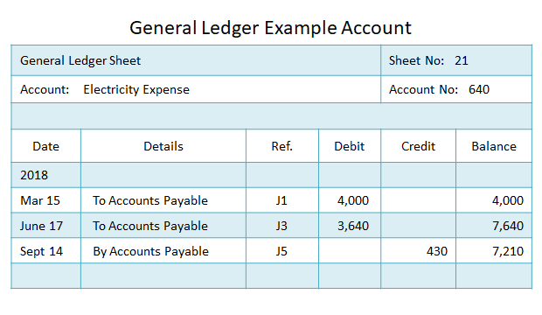

Slide 21
Exercise 1.1
Discussion Questions: (10 points each number)
1. In your own understanding, why is financial statement important in business?
2. Why is accounting entity an important underlying assumption in accounting?
3. Reflect on your current financial position. How much assets do you have? How much liabilities? How will you convert your current financial status into a basic accounting equation?

Slide 22
Identify below items listed and categorize according to the elements of the financial statements (ASSET, LIABILITIES, EQUITY, INCOME, EXPENSES)
# | Chart of Accounts | # | Chart of Accounts
1 | Accounts Payable | 11 | Furniture and Fixture
2 | Accounts Receivable | 12 | Imang, Drawing
3 | Trademark | 13 | SSS/PHIC/HDMF Payable
4 | Salaries and Wages Expenses | 14 | Fuel and Lubricants
5 | Prepaid Rent | 15 | Prepaid Insurance
6 | Ministore Sales | 16 | Service Income
7 | Advertising | 17 | Loans Payable
8 | Cash in Bank | 18 | Inventory
9 | Imang, Capital | 19 | Rental Revenue
10 | Light and Water | 20 | Rent Expense

Slide 23


Slide 24


